Slide 1

Loan Default Predictions
By: Tyler Brown

Slide 2

Lending Club Problem
Customers are defaulting on their loans
Easier way to accept or refuse loan applications
Minimize possible future loan defaults
Notes:
Customers who have taken loans from Lending Club have failed to pay their loans on occasion. To reduce the probability of defaulted loans, Lending Club would like to predict the likelihood of customers defaulting on their loan using only the information provided in the dataset. Lending Club will be able to use the model to determine how accurate the predictions are for future loan defaults and minimize the risk of future loan defaults.

Slide 3

The Dataset
id: Unique ID of the loan application.
grade: LC assigned loan grade.
annual_inc: The self-reported annual income provided by the borrower during registration.
short_emp: 1 when employed for 1 year or less.
emp_length_num: Employment length in years. Possible values are between 0 and 10 where 0 means less than one year and 10 means ten or more years.
home_ownership: Type of home ownership.
dti (Debt-To-Income Ratio): A ratio calculated using the borrower’s total monthly debt payments on the total debt obligations, excluding mortgage and the requested LC loan, divided by the borrower’s self-reported monthly income.
purpose: A category provided by the borrower for the loan request.
term: The number of payments on the loan. Values are in months and can be either 36 or 60.
last_delinq_none: 1 when the borrower had at least one event of delinquency.
last_major_derog_none: 1 borrower had at least 90 days of a bad rating.
revol_util: Revolving line utilization rate, or the amount of credit the borrower is using relative to all available revolving credit.
total_rec_late_fee: Late fees received to date.
od_ratio: Overdraft ratio.
bad_loan: 1 when a loan was not paid (target).
Notes:
File lending_club_loan_dataset.csv within the repository contains data used for determining loan default predictions. To help the Lending Club, my goal is to predict the "bad_loan" column. This column documents whether the loan was paid or not, where “0” means the loan was paid and “1” means the loan was not paid. The remaining columns of data will be used to help predict the likelihood of loan defaults.

Slide 4
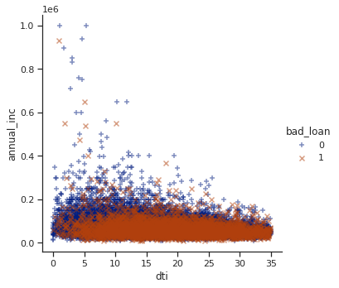
Correlation Between Annual Income and Debt-to-Income
many low-income customers defaulted on their loan no matter if their debt-to-income ratio is high or low
the annual income increases, the debt-to-income is less, and fewer customers defaulted on their loan
customers with lower debt-to-income ratio and a higher salary will not default their loan
Notes:
The scatterplot shows the correlation between the debt-to-income and annual income features with each being marked based on those who defaulted on their loan. From the data, we can determine many low-income customers defaulted on their loan no matter if their debt-to-income ratio is high or low. However, as the annual income increases, we can notice the debt-to-income is less and less customers defaulted on their loan. Stakeholders should be aware many of those with lower debt-to-income ratio and a higher salary will not default their loan.

Slide 5
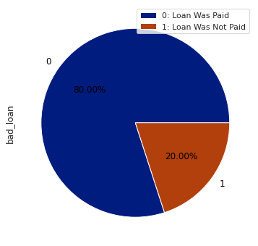
Loan Default Percentages
80% of customers paid their loans
20% of customers failed to pay their loans
1 of 5 customers default their loan
Notes:
This pie chart shows the percentage of defaulted loans based on the dataset. As we can see, 80% of customers paid their loan off, while 20% of customers did not pay their loan off. This data can be used to identify a ratio of customers who pay their loan off or not. We can see for every customer who defaults their loan, 4 customers paid their loans. The objective is to attempt to reduce this failure to pay through a predictive algorithm.

Slide 6
Strengths
Data that supports prediction
Most data used in model
Useful forecasting utilization
Notes:
There are a few strengths when using the dataset. With most columns utilized in predicting the defaulting of loans, we can have a more accurate model to work with. There are a few columns of little use to the model, which have been assessed and adjusted appropriately. Predicting loan defaults can be useful as it eliminates risks from the business loaning to a customer and a customer putting themselves further into unnecessary debt.

Slide 7
Limitations
Presented with missing values in the dataset
No additional data is available for greater accuracy in predictions
Classification Models
Notes:
Throughout the course of modeling the data, there were a few limitations as well. There is missing data provided by Lending Club, which will cause slight inconsistencies in making predictions. Additionally, we are limited to a few supporting columns to meet our target. With our target being a ‘yes’ or ‘no’ question, we can only use classification models to make this prediction.

Slide 8
Recommendations
From the Logistic Regression, KNN, and Random Forest models, the best machine learning model would be the Random Forest model with PCA because it maximized the predictive capability of the risk of future loan defaults. Though the false positives were high, the Random Forest model provided the highest number of true negatives, which minimizes false reports for Lending Tree. This way, Lending Tree can have a better probability to predict if borrowers will not pay and prevent the risk as much as possible.
Notes:
From the Logistic Regression, KNN, and Random Forest models, the best machine learning model would be the Random Forest model with PCA because it maximized the predictive capability of the risk of future loan defaults. Though the false positives were high, the Random Forest model provided the highest number of true negatives, which minimizes false reports for Lending Tree. This way, Lending Tree can have a better probability to predict if borrowers will not pay and prevent the risk as much as possible.

Slide 9
For Further Information…
If there are any additional questions, I can be contacted at alpha.curse@gmail.com
Notes:
If there are any further questions, I can be contacted at alpha.curse@gmail.com.

